Slide 1
Division Admin Tasks
This is a list of admin tasks that need to be regularly reviewed and actioned by someone in the division leadership team. As always these can be distributed across a few people so they don’t all have to be done by the division commissioner.
Category | Tasks | Frequency | Where can I find it?
Safe Space | Reminding leaders to do or renew their safe space 1 & 2 | At least monthly
Inactive Roles | Checking that volunteer roles are active and actioning roles that are inactive | At least monthly
DBS Renewals | Assigning an ID verifier Ensuring that DBS renewals are done before the DBS expires | Weekly
Long Service Awards | Making sure that voluteers are rewarded for their long service | Once a term
New Volunteer References | Ensuring initial DBS checks are done within 4 months of the volunteer starting Entering references | Adhoc, when required but check for updates weekly
Volunteers turning 18 | Letter of recommendation Update the volunteer role | Adhoc when required but check the list monthly
First Response | Reminding volunteers to do the First Response e-learning and book on to a First Response Training Checking that each unit has a volunteer with first response | Monthly

Slide 2
Safe Space Admin
Next Steps – contacting volunteers
All volunteers will get an email to let them know that they have a communication in GO. This communication will let them know when their Safe Space is due to expire within 4 months. They will also get reminders nearer the time.
They can access the Safe Space training on the Girlguiding Learning Portal Girlguiding: Log in to the site
Here is an example of an email / text you could send them if you are getting concerned that they still haven’t completed their training:-
Hi <insert name of volunteer>
GO tells me that your safe space is due in to expire soon. All volunteers must have the right levels of A Safe Space training for their role. If you don’t complete this in time your membership will be withdrawn.
To do the A Safe Space level 1, you can go to a training session or complete the module one e-learning on our learning platform.
The e-learning takes just 20 to 25 minutes.
If it’s your first time on the learning platform, click on the ‘need help logging in’ button to get instructions on how to set up your password.
Please can you let me know when you have been able to do this and if you have any concerns about it please get in touch.
Kind Regards
<insert your name>
Division Commissioner (or other role if its another member of the leadership team)
Email: <insert email>
Make sure the volunteer has your email and a contact number if you are happy for them to message or ring you.

Slide 3
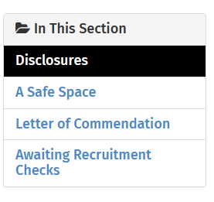
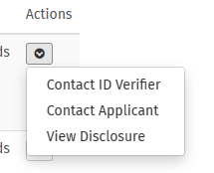
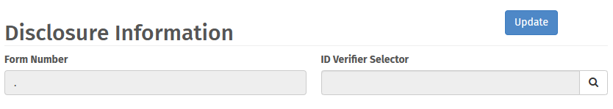
DBS Admin
Assigning an ID Verfifer
Sign in to GO as a commissioner and select your Division
Go ‘Safe Practice’
Select ‘Disclosures
In the drop down list select ‘view disclosure’
In the pop up select ‘ID Verififier Selector’ and make a selection from the drop down list and press ‘Update’
Its useful to let the ID verifier know you have assigned someone to them.

Slide 4
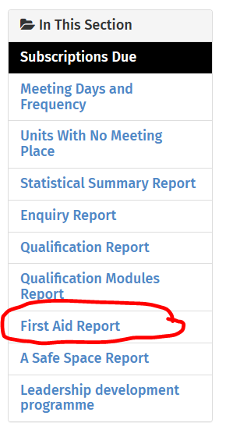
First Response Admin
Check that each unit has a volunteer with First Response
Sign in to GO as a commissioner and select your Division
Go to ‘Reports’
And then ‘First Aid Report
In the drop down list select ‘units where the first response expires within 6 months’
Note: You may find it useful to cross check the volunteers qualifications individually as sometimes their first response hasn’t been entered correctly

Slide 5
First Response Admin
Check that each unit has a volunteer with First Response
Sign in to GO as a commissioner and select your Division
Go to ‘Reports’
And then ‘First Aid Report
In the drop down list select ‘units where the first response expires within 6 months’
Check that each unit has a volunteer with First Response
Sign in to GO as a commissioner and select your Division
Go to ‘Reports’
And then ‘First Aid Report
In the drop down list select ‘TBC’
Note: You may find it useful to cross check the volunteers qualifications individually as sometimes their first response hasn’t been entered correctly

